Slide 1
Chi-Squared, Exponential, and Gamma
Aubrey Smiley McAuliffe and Matt Sparr

Slide 2
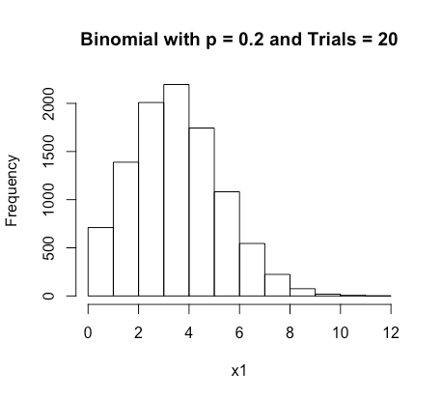
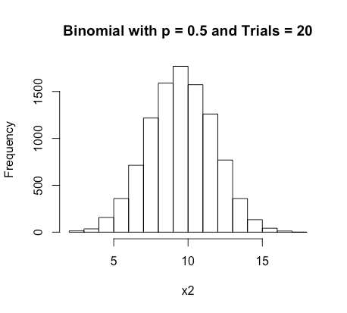
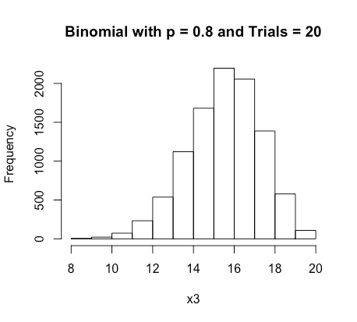
What do Binomial PMFs look like?

Slide 3
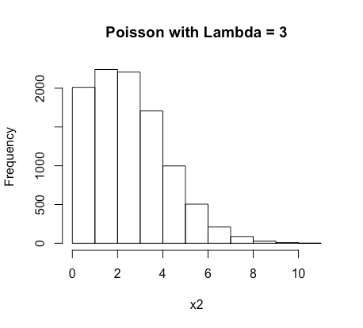
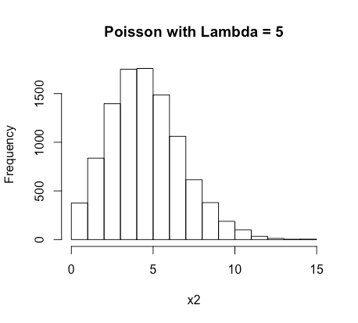
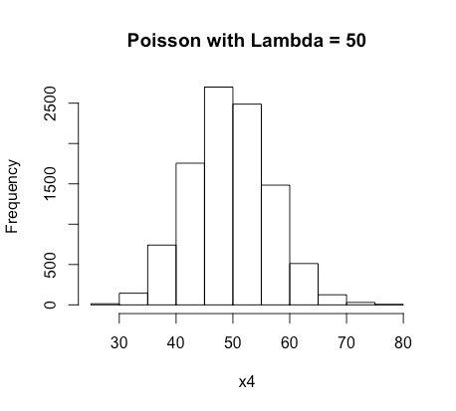
What do Poisson PMFs look like?

Slide 4
Continuous Distributions Outside the Norm
Many of the better known statistical procedures operate in the framework of Normal and Student’s t distributions. However, there are a plethora of other beautiful and useful distributions to learn about

Slide 5
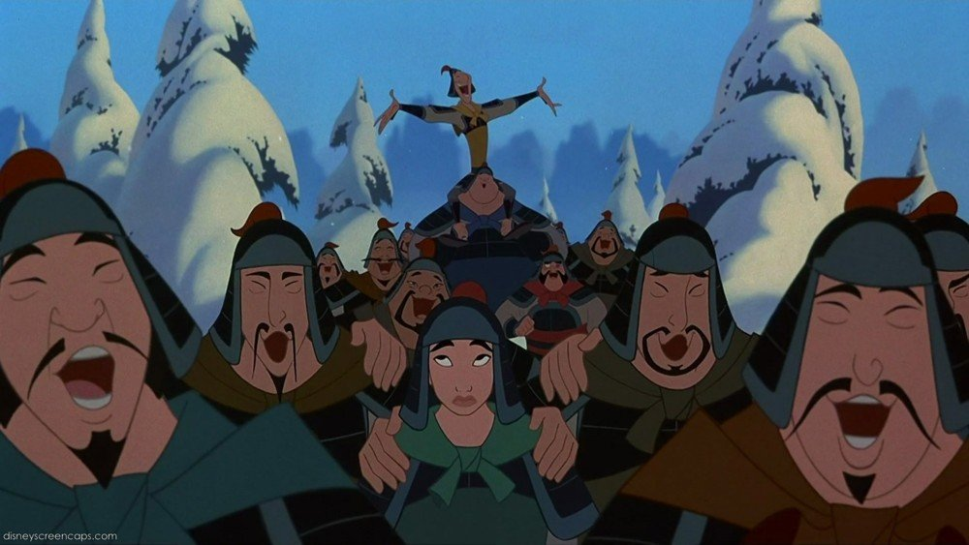
Distributions Worth Fighting For
Distributions Worth Fighting For!

Slide 6
Chi-Squared Distribution
Models the sum of squared Individually, Identically Distributed (IID)Standard Normal Distributions
This is extremely useful for Goodness of Fit Tests
Residuals between Predicted and Actual for a given value can manifest as IID Z distributions.
Sum of Squared Residuals, amalgamating into a Chi-Squared, can tell you whether data follows the model you think it does
The number of Z distributions being added together is k, the degrees of freedom for the Chi-Squared distribution

Slide 7
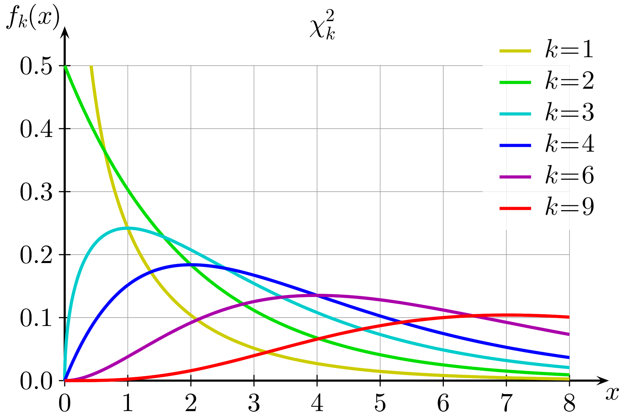
Chi-Squared with Varying Degrees of Freedom

Slide 8


Exponential Distribution
Describes the time/distance between events in a Poisson Process
Memoryless: Time until the next event is not dependent upon how much time has passed
PDF:
CDF:
Poisson describes the rate of occurrence; Exponential describes the time between occurrences
If Poisson has 10 customers per hour, 10 customers in 60 minutes, lambda= 10.
Exponential for that same scenario: 10 customers/60 minutes = 1customer/6minutes, time between customers is 6 minutes. Lambda=6
Mean = 1/lambda, Variance = 1/(lambda^2)

Slide 9
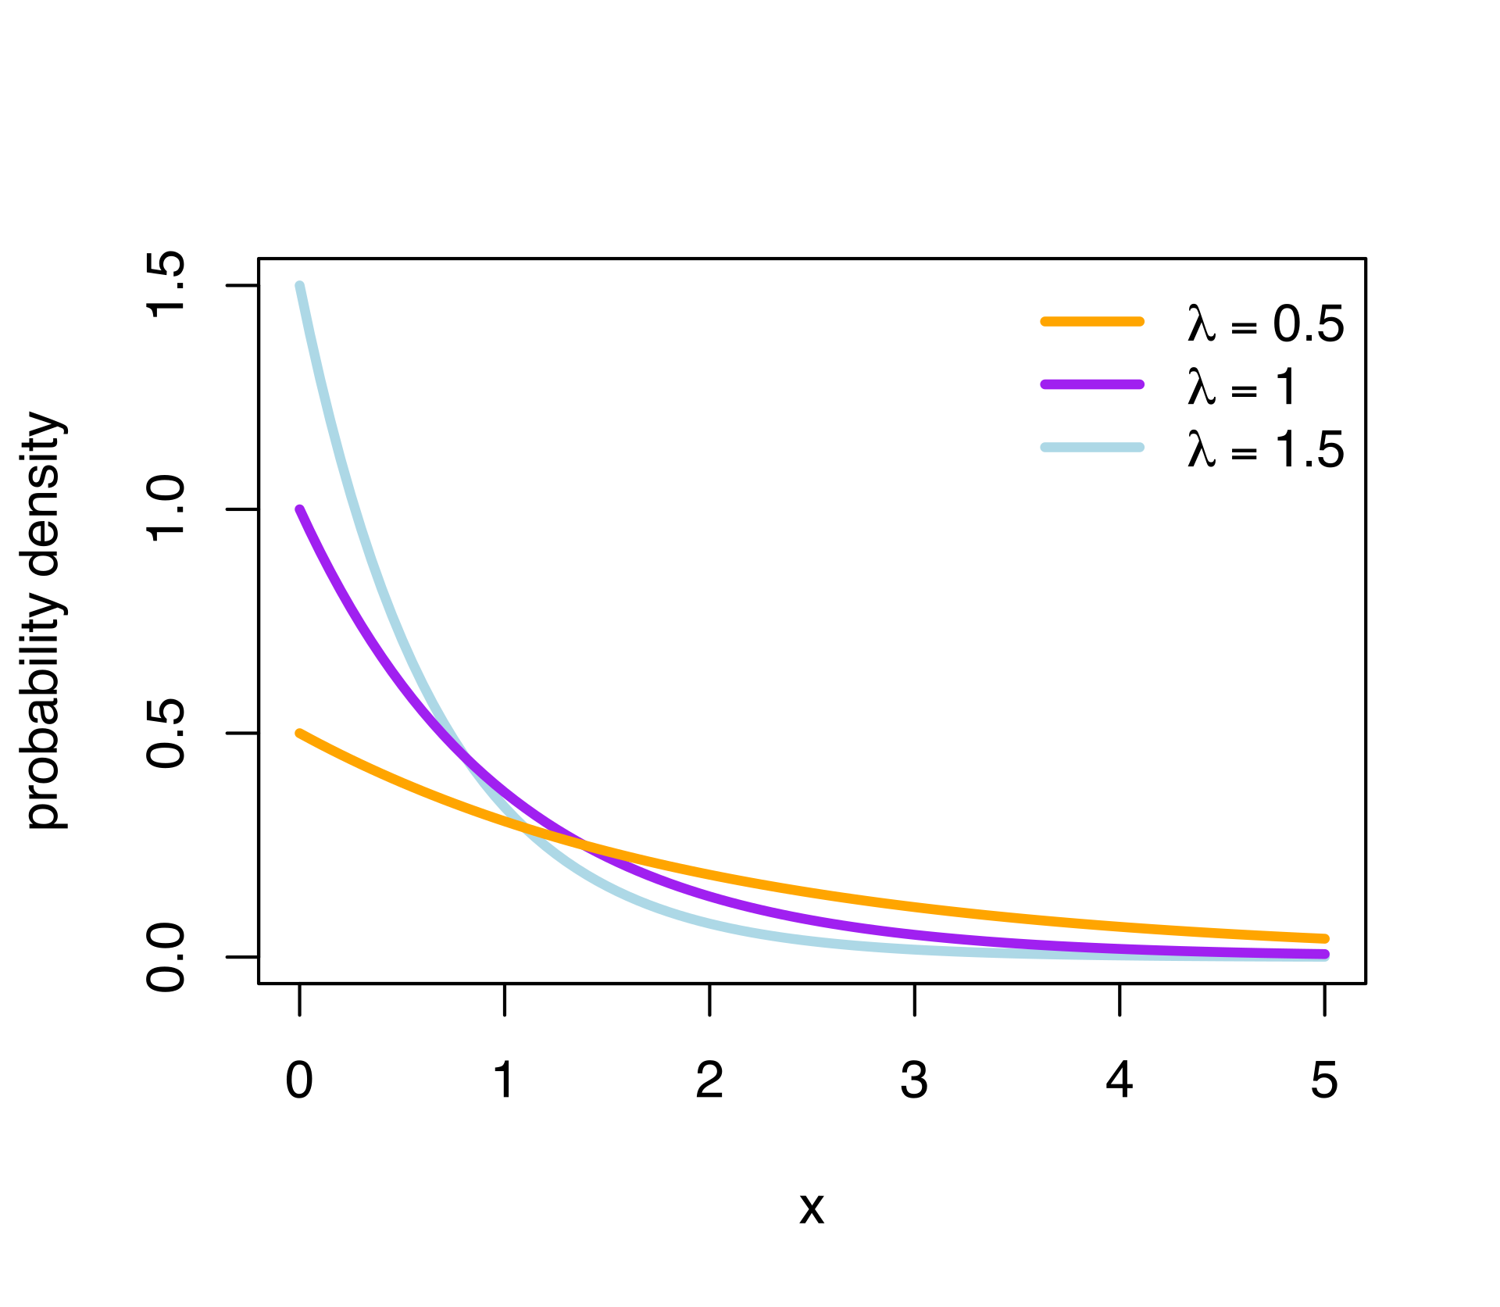
Exponential Distributions with Different Lambdas

Slide 10

Gamma Distribution
Can be thought of as modeling the waiting times in between Poisson Events
PDF:
K is a shape parameter (Measure of how many Exponential Distributions are included)
Theta is a scale parameter (Waiting time between each event in the Poisson process (exponential lambda))
Expected Value = k*theta
Variance = k*theta^2

Slide 11
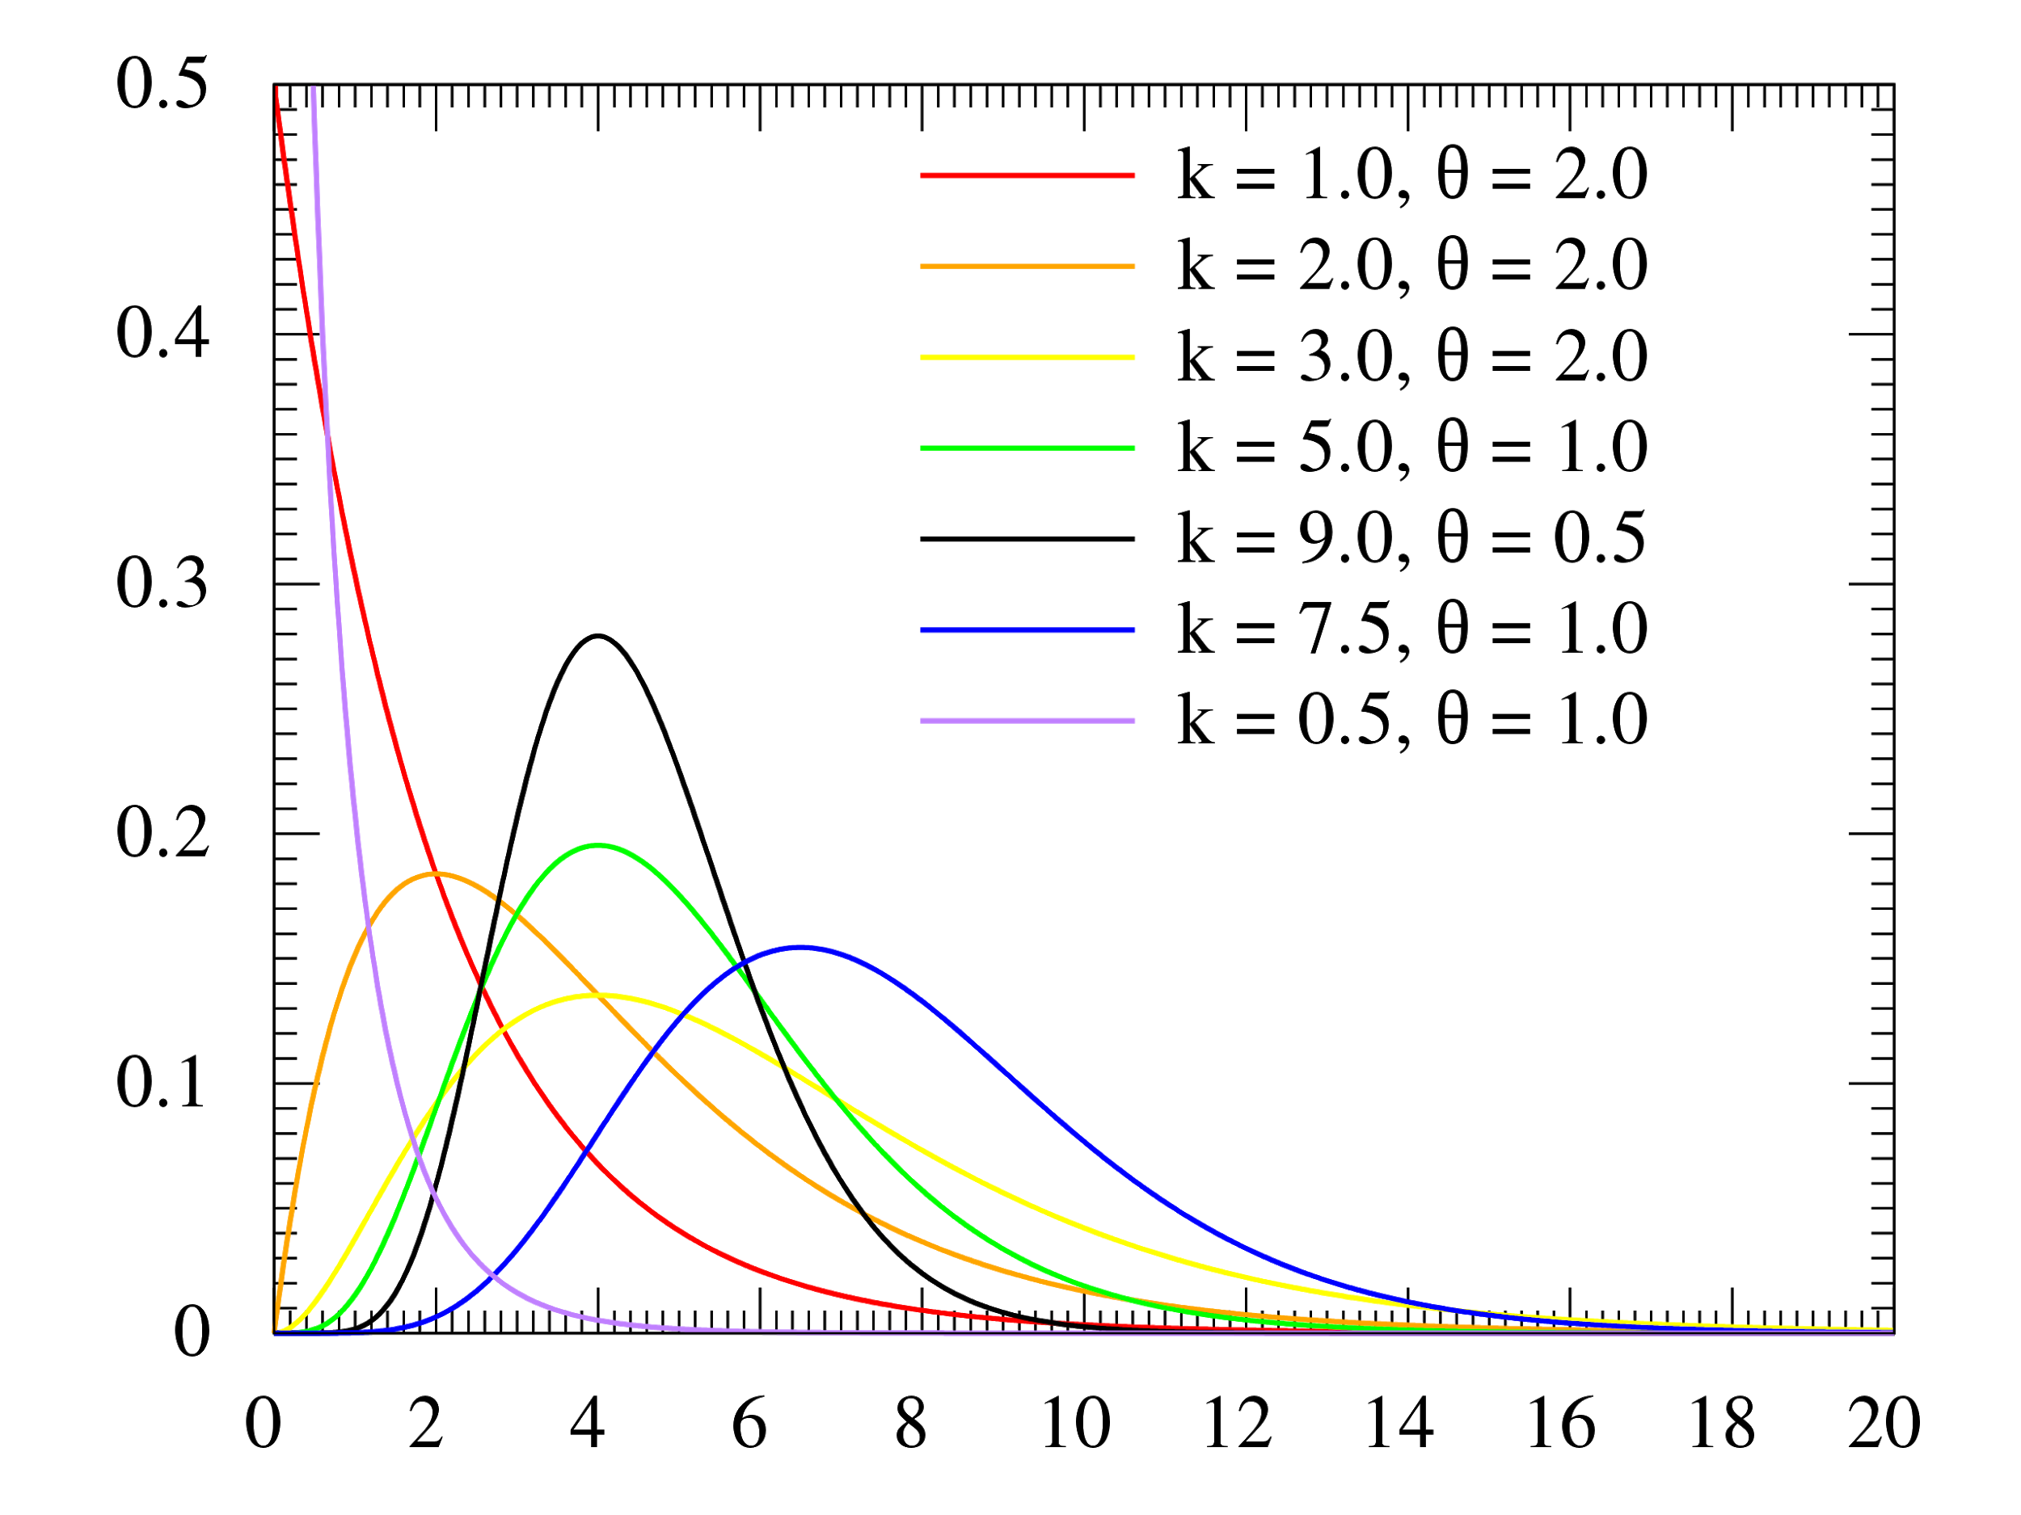
Gamma Distributions with Varying k and theta

Slide 12
Example
When webscraping, you set up your code so that a request is sent to an API 15 times per hour.
If you set up three separate usernames which all request at the same rate. How long is the expected wait between requests if all three are involved?

Slide 13
Practice Problems

